Slide 1
Principles in Leadership
Mr. Rolfe

Slide 2
Principles in Leadership Introduction
Today we are going to:
1. Introduce the teacher
2. Introduce the classwork
3. Introduce the classroom
4. Introduce the students

Slide 3

Who is this new foreign teacher?
From Halifax, Nova Scotia, Canada.
Happily married to my wife, Elizabeth, for 34 years.
Have been a teacher of high school Science for 8 years in Canada and an English professor in China for 4 years.
Have 4 adult children still living in Canada.

Slide 4
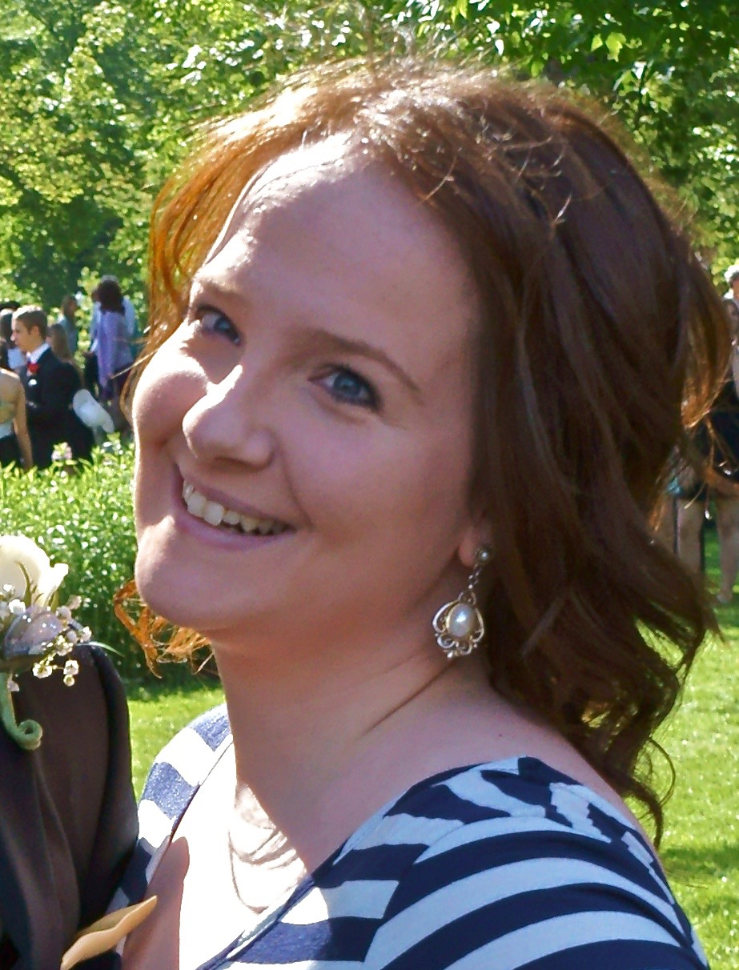
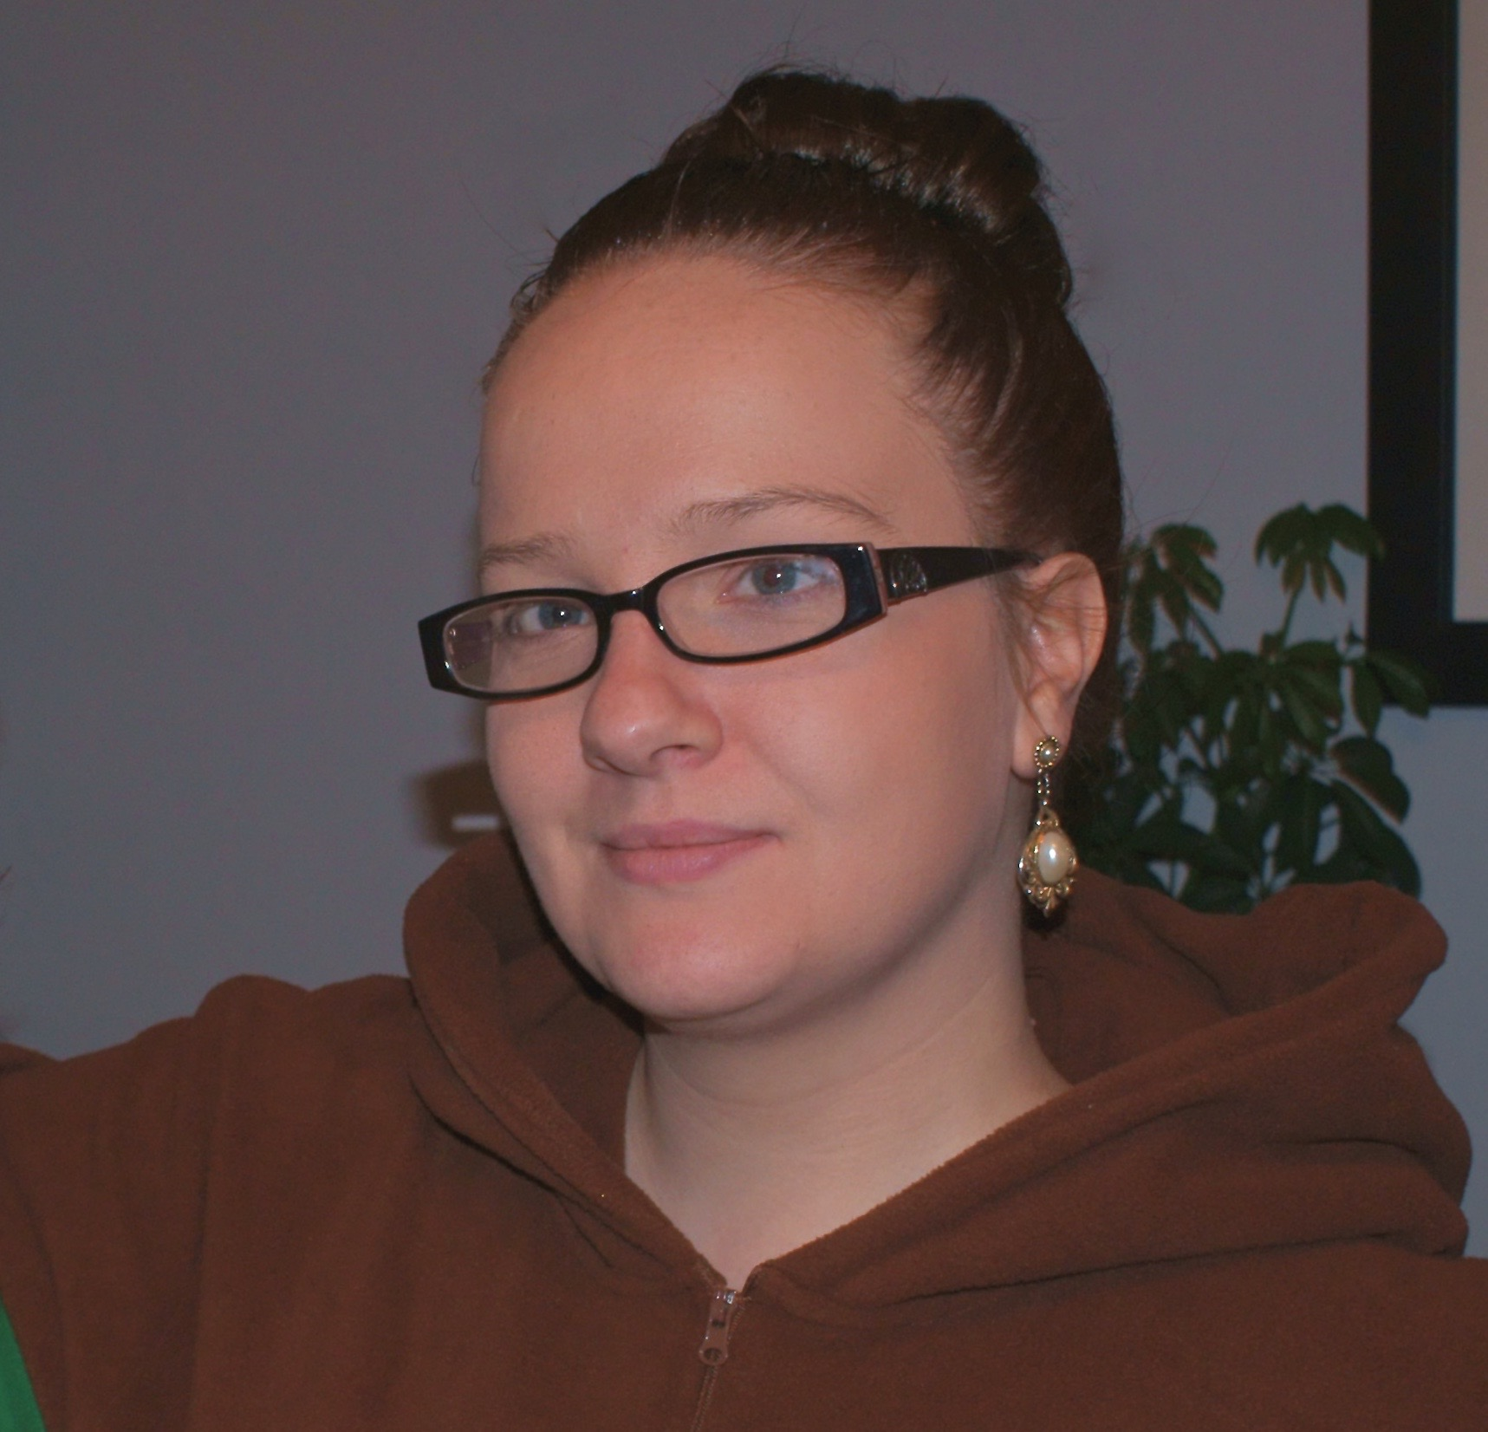
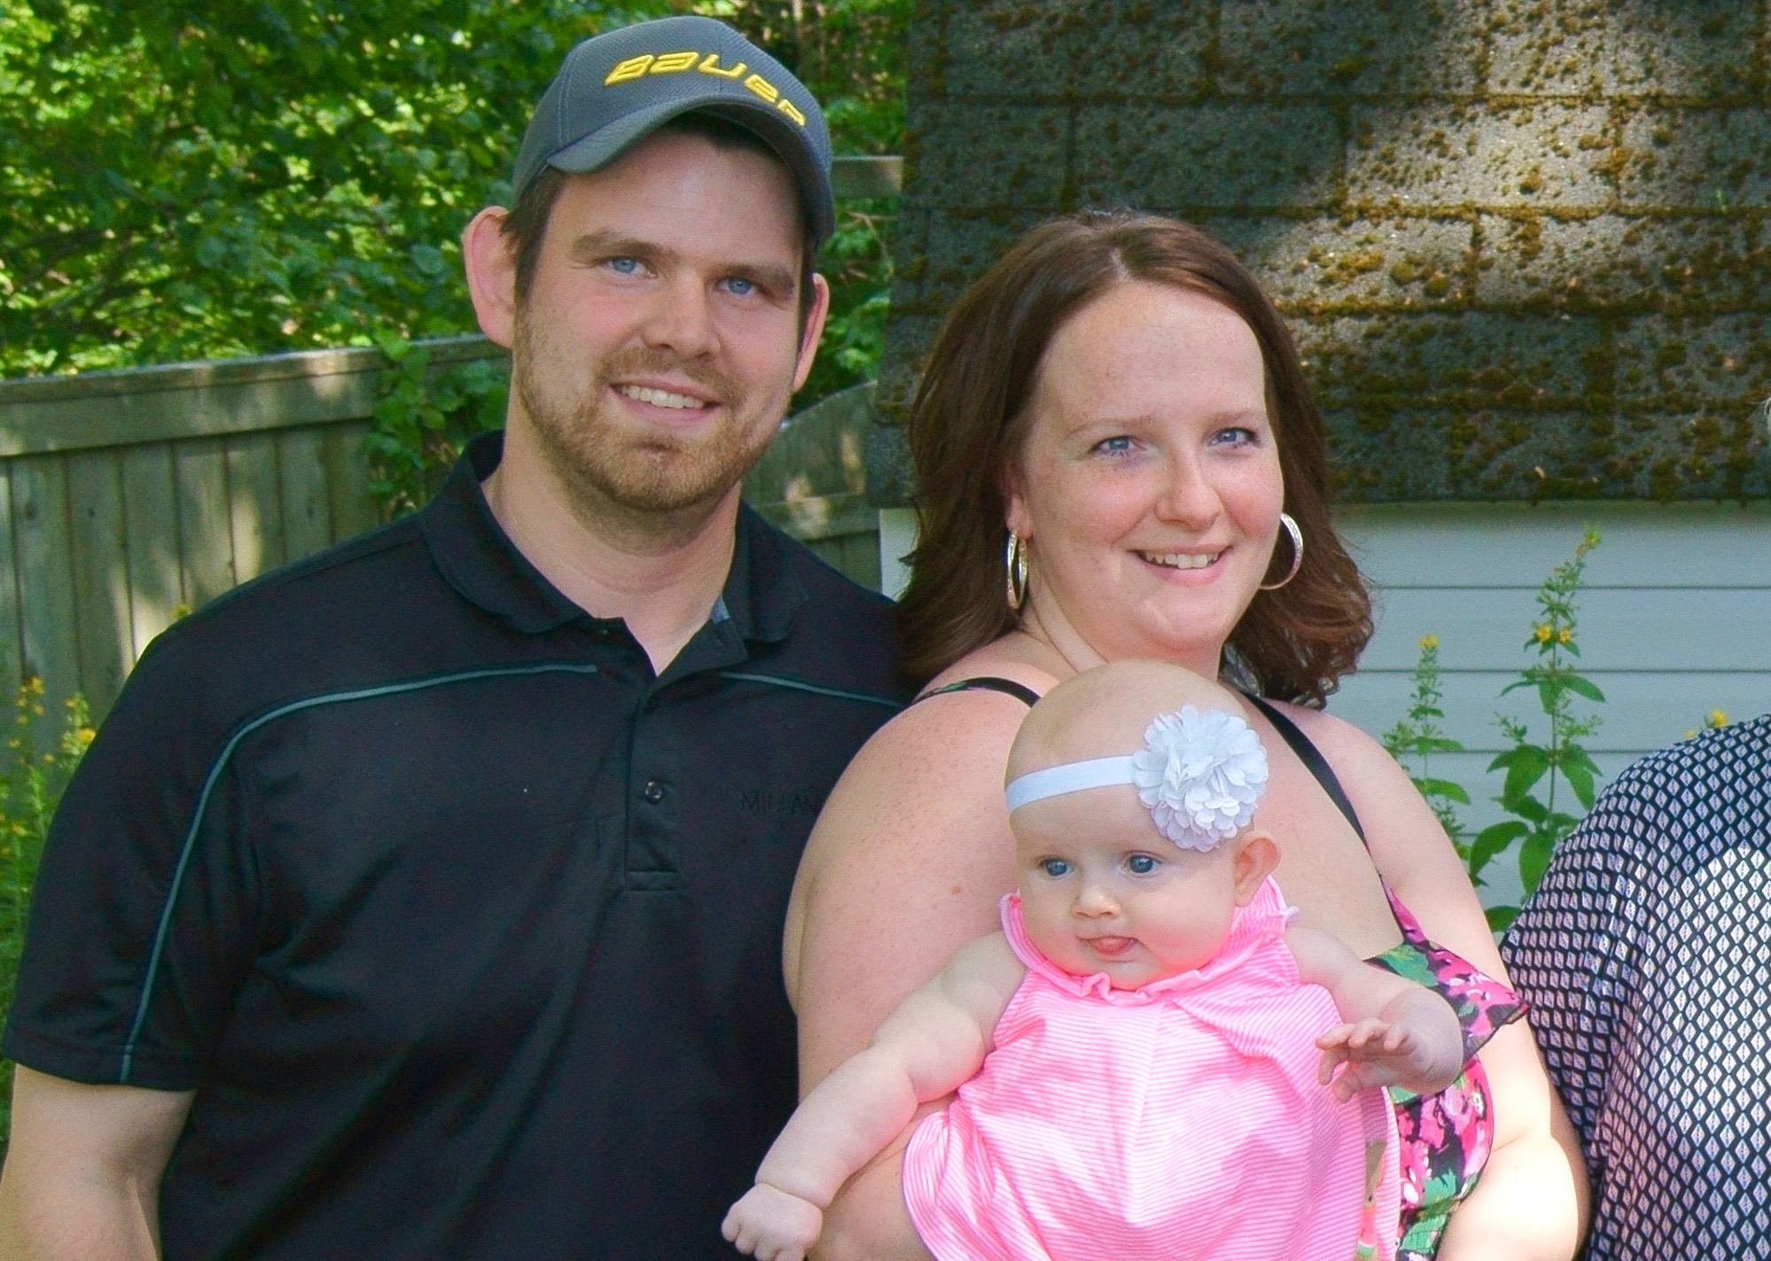
Leah
Is a successful hairdresser.
30 years old
This is Leah with her husband Steve and our granddaughter, Autumn.

Slide 5

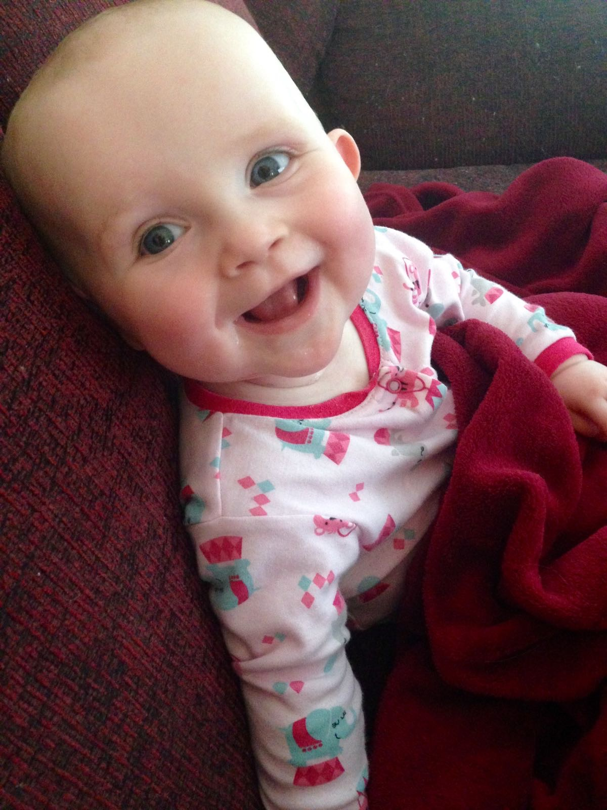
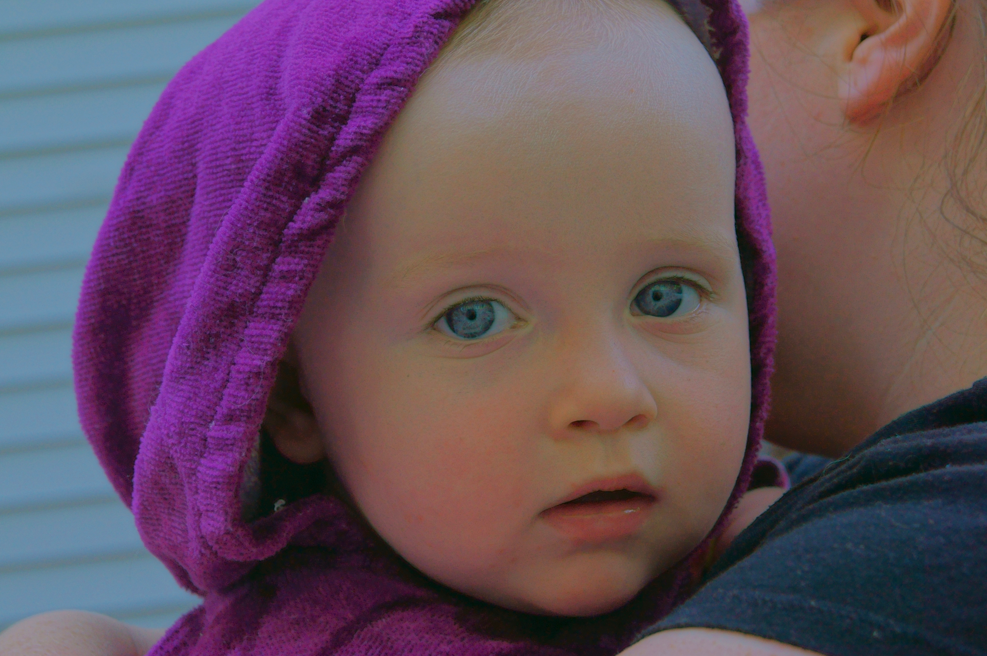
Our Granddaughter, Autumn Elizabeth

Slide 6
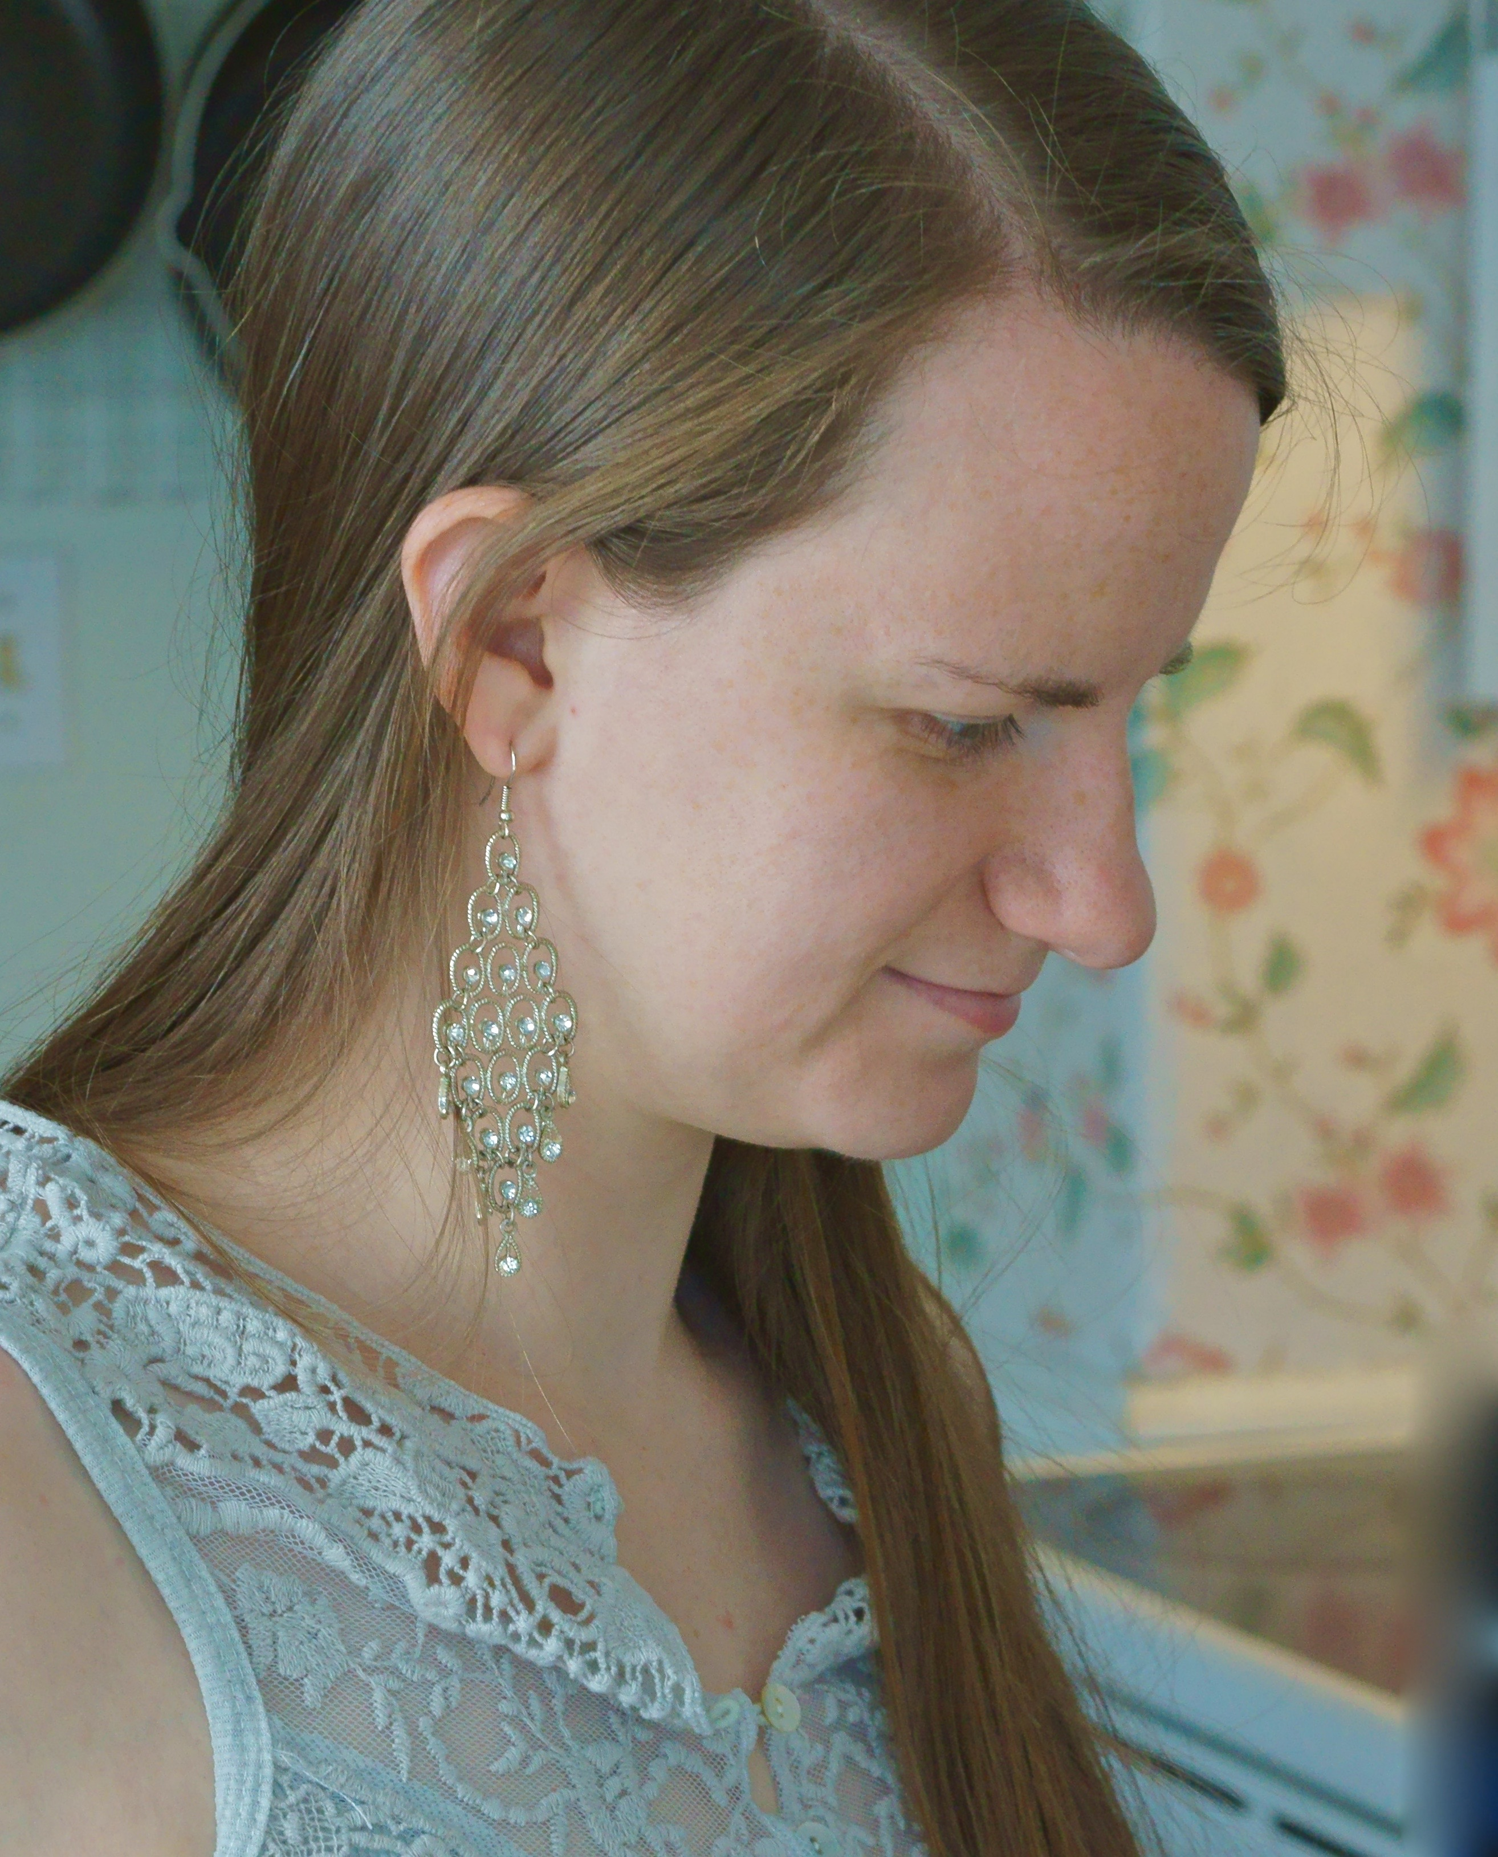

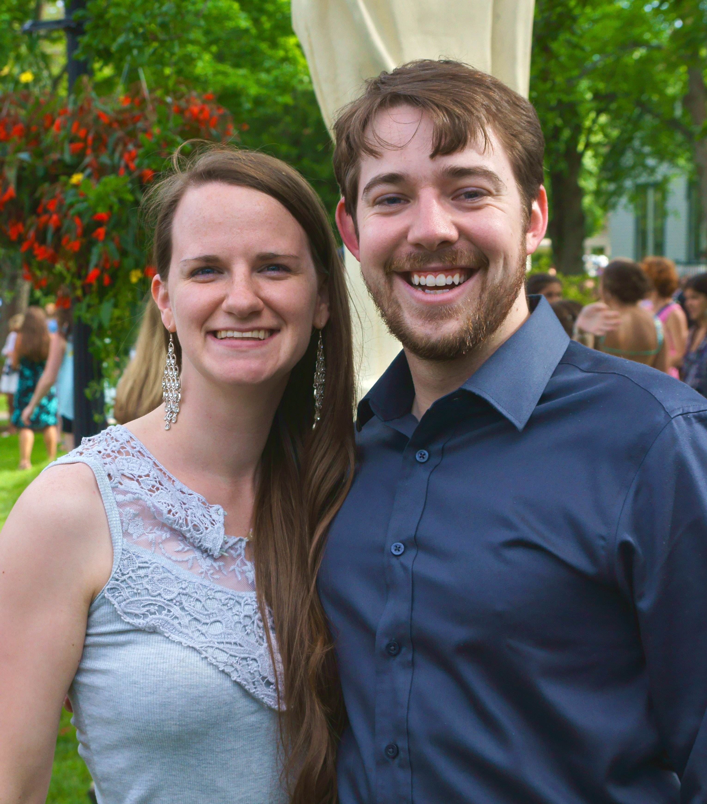
Joy
Has graduated from University with a BA in English.
28 years old
(with a minor in Chinese studies)
She currently lives with her husband Josh in Halifax.

Slide 7
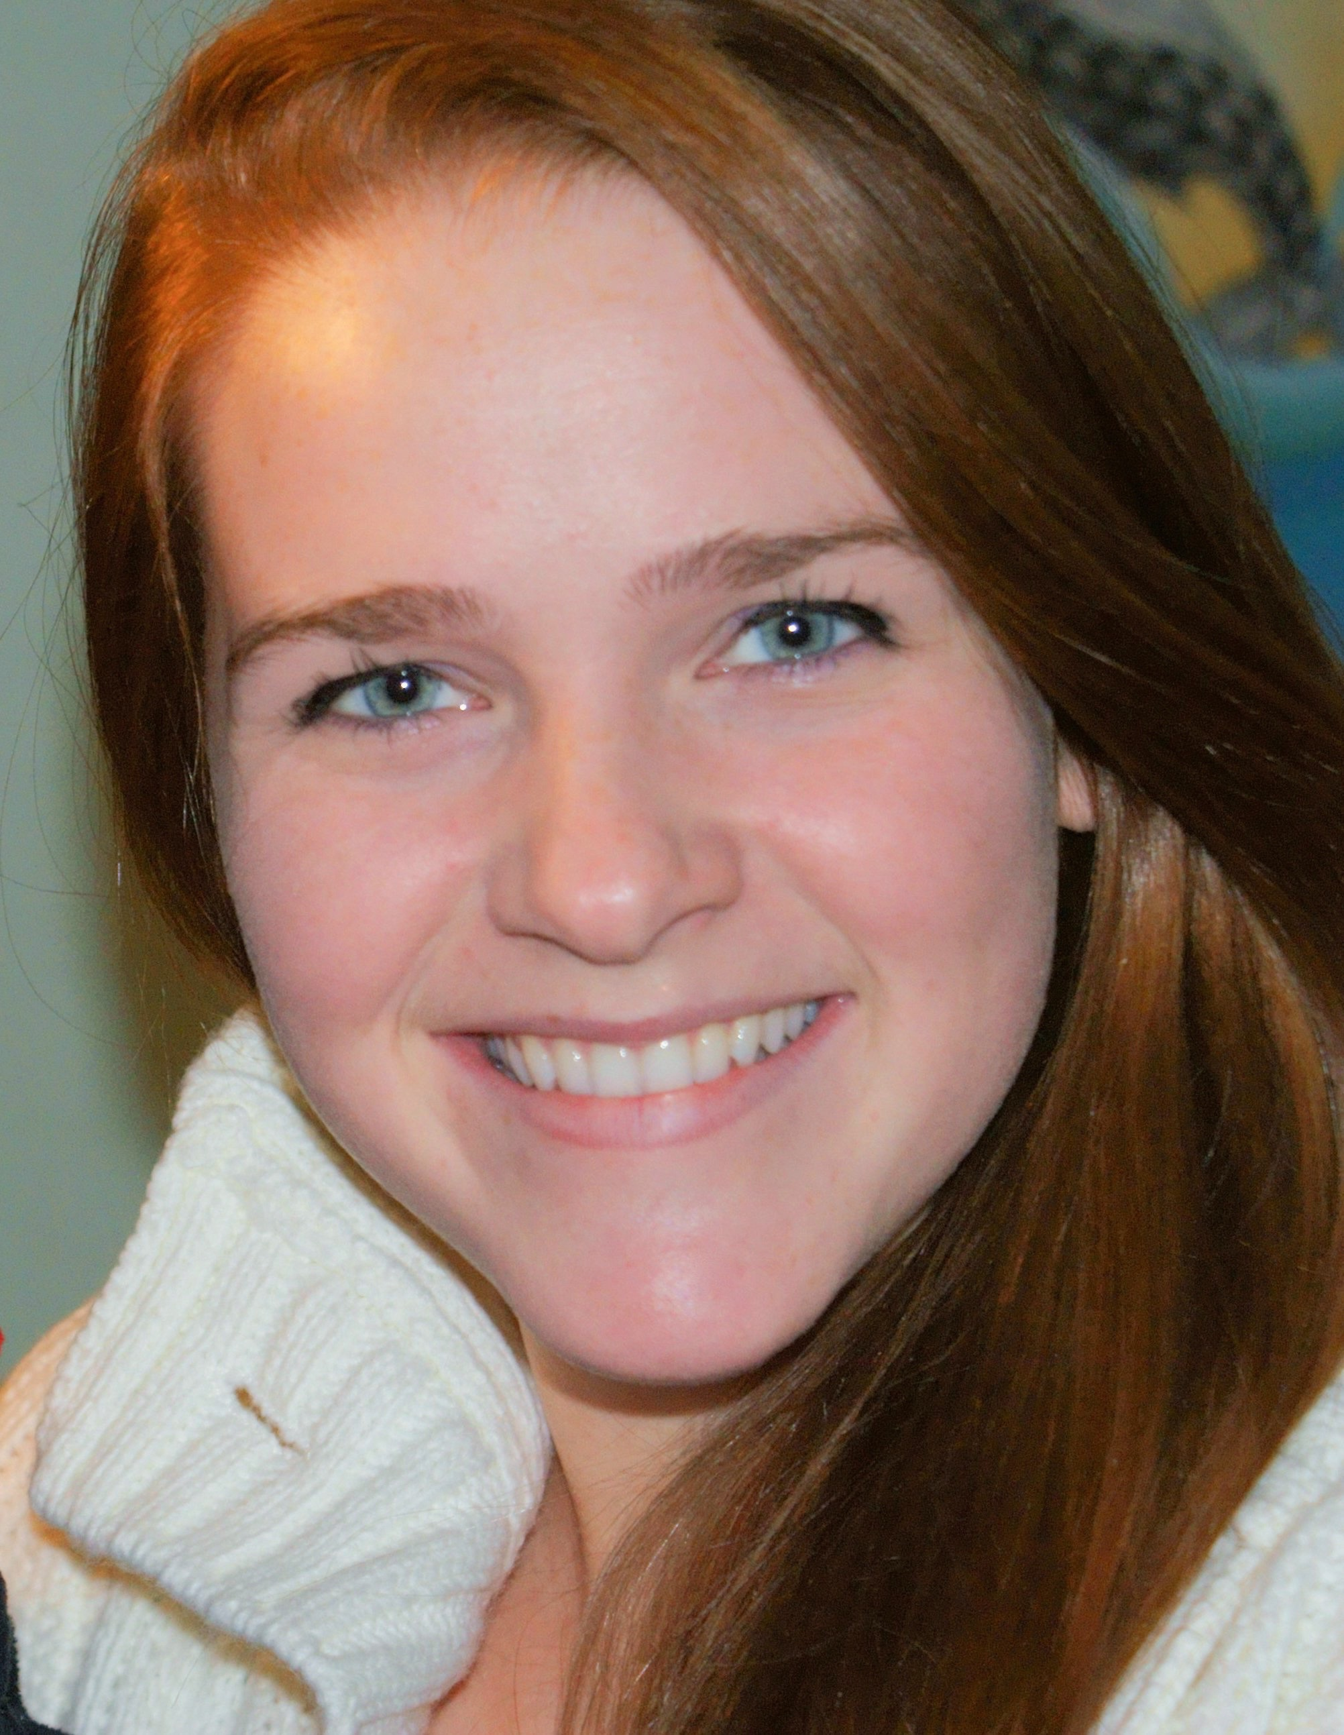
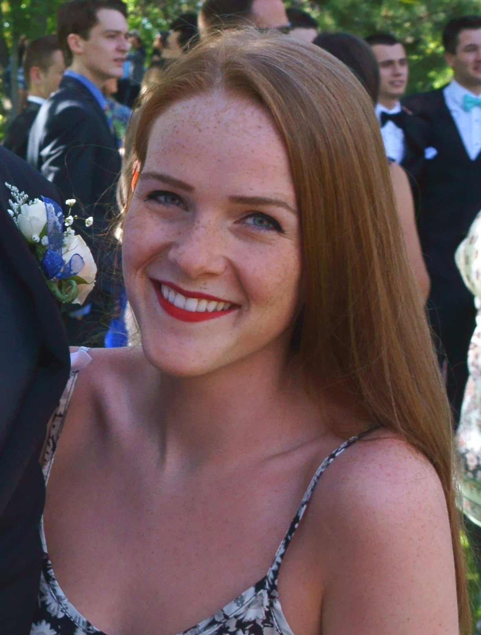
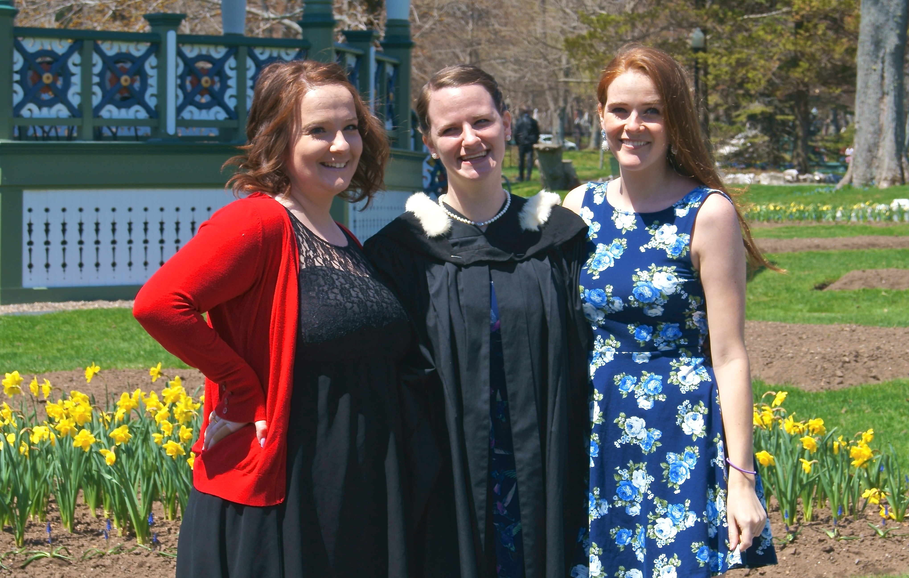
Amber
Is an artist.
26 years old
Is studying in University to get her MA in History.

Slide 8
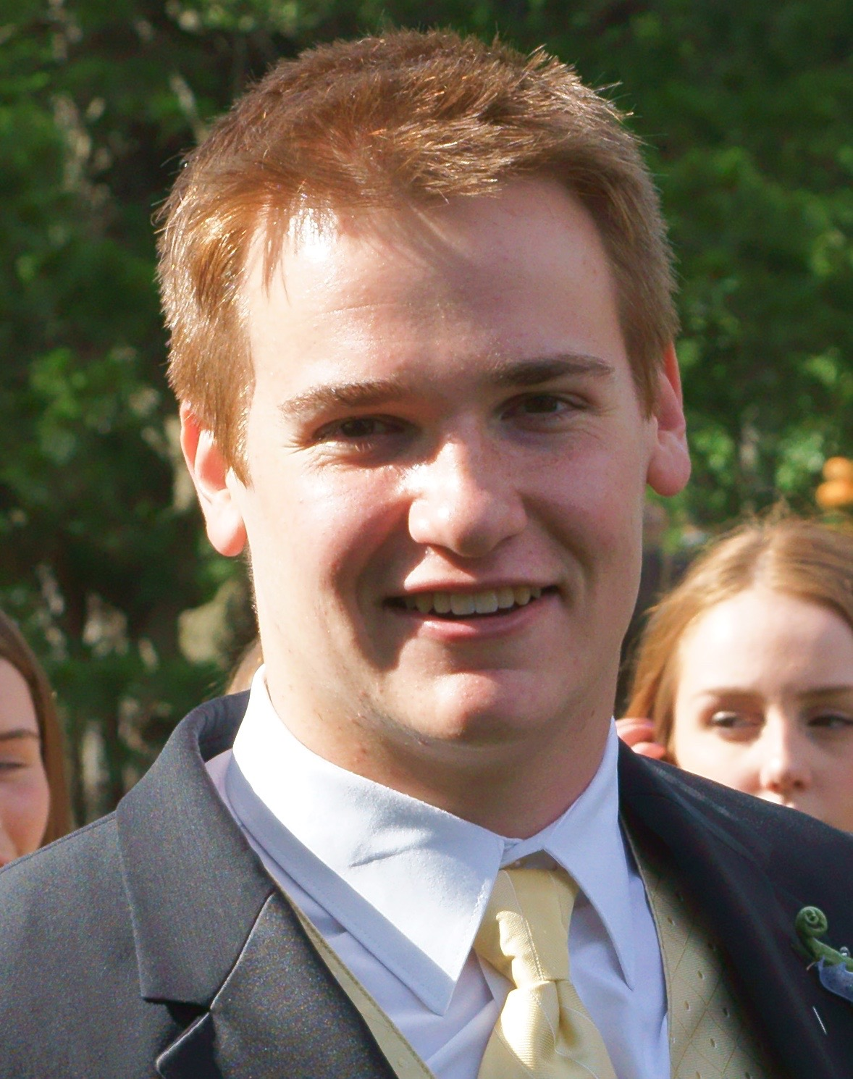
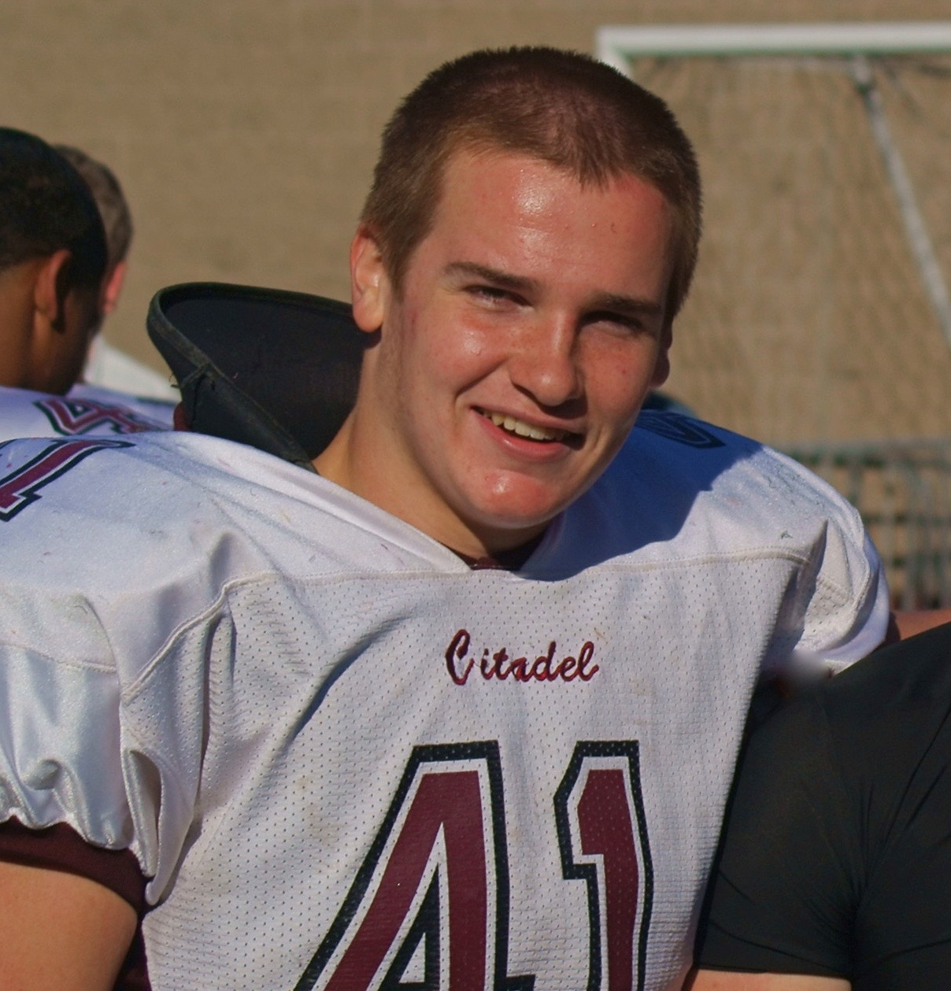
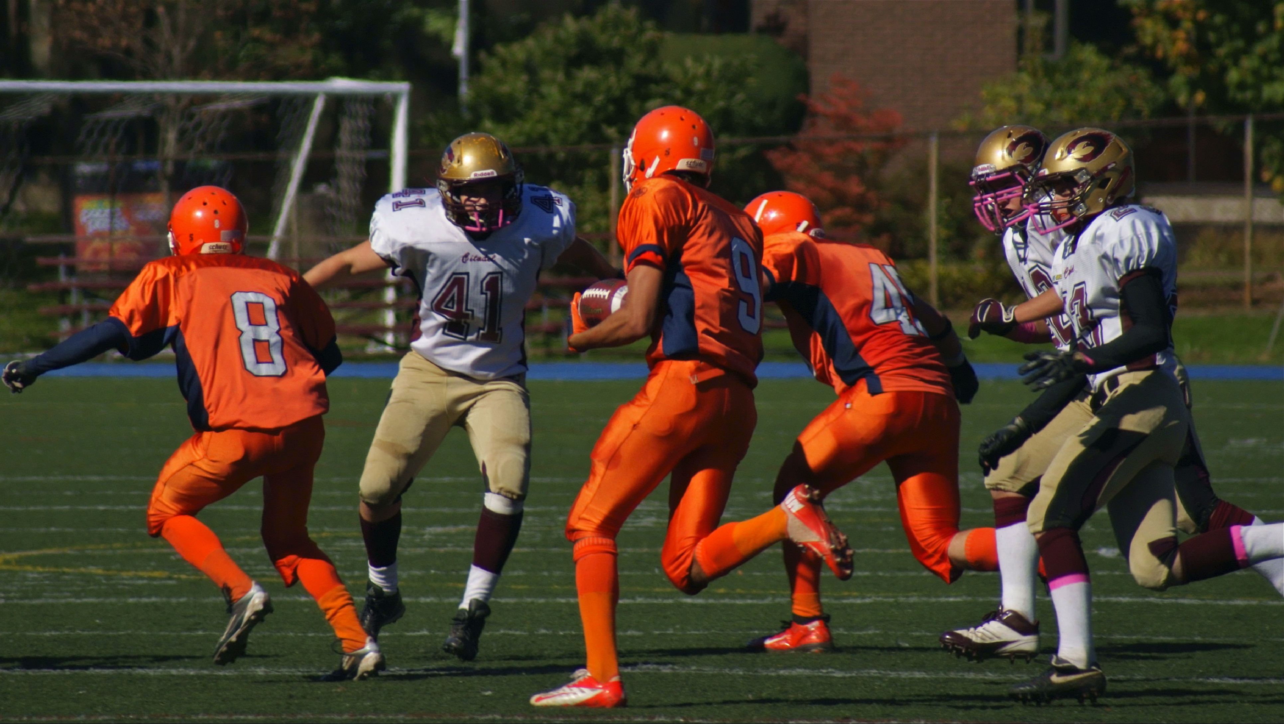
Sam
Loves playing sports.
22 years old
He has just graduated from university in Mineral Engineering.

Slide 9
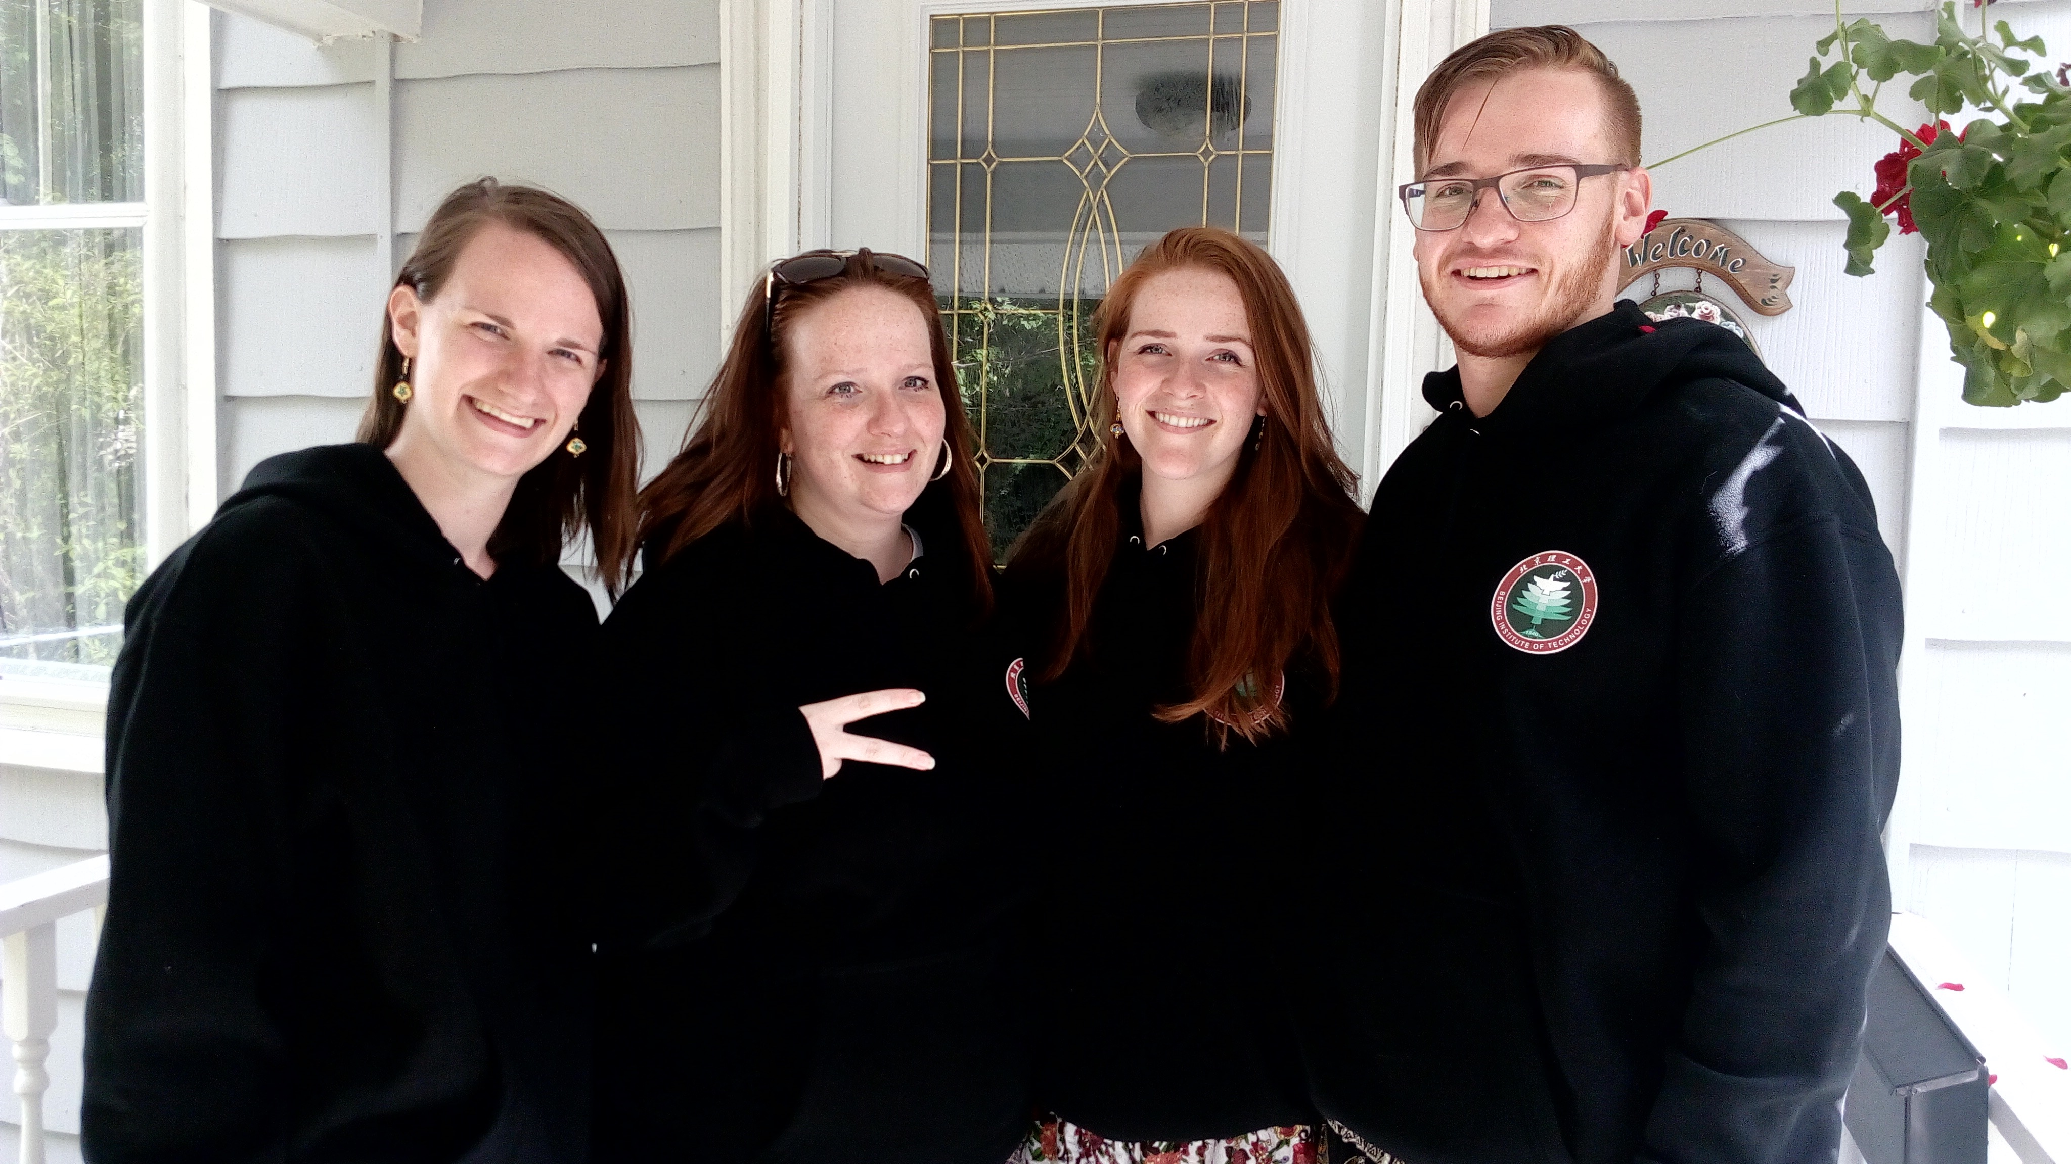
My children wish they could be here.

Slide 10
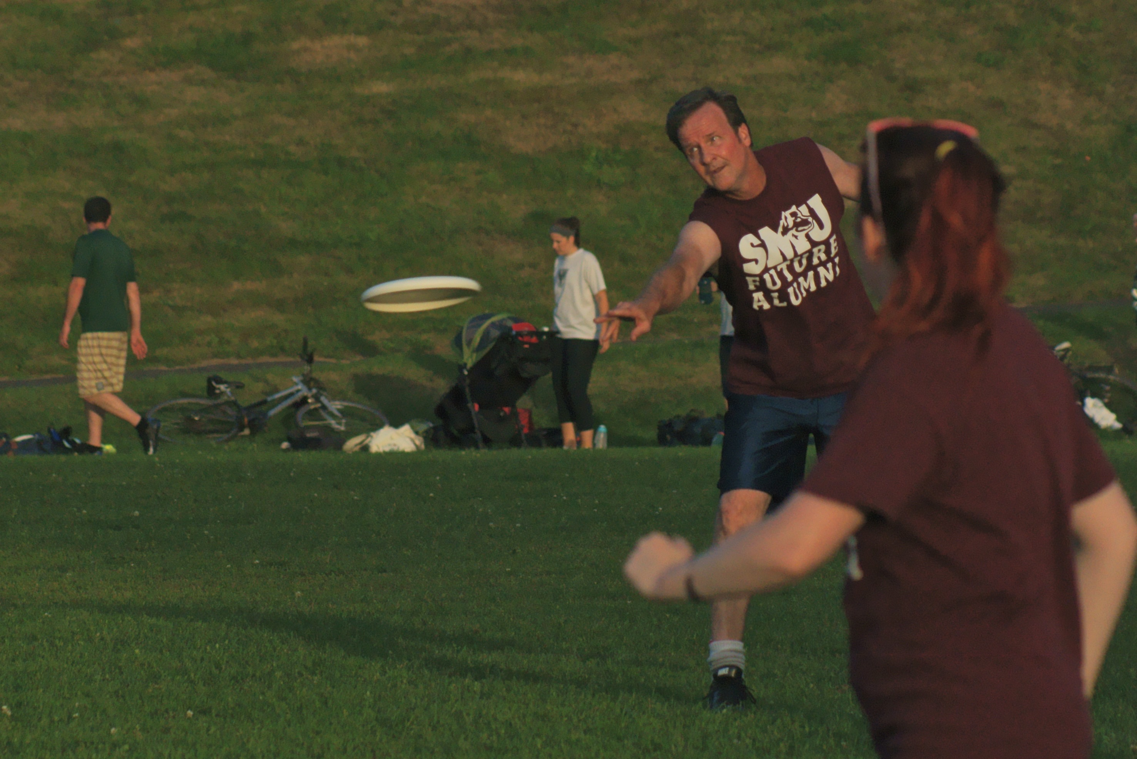
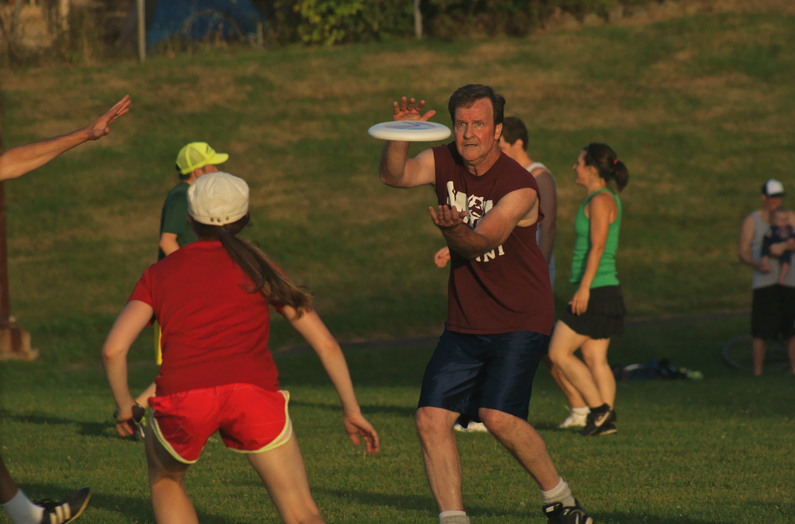
My Hobbies: Sports
I like to play Ultimate Frisbee...
…and basketball.

Slide 11
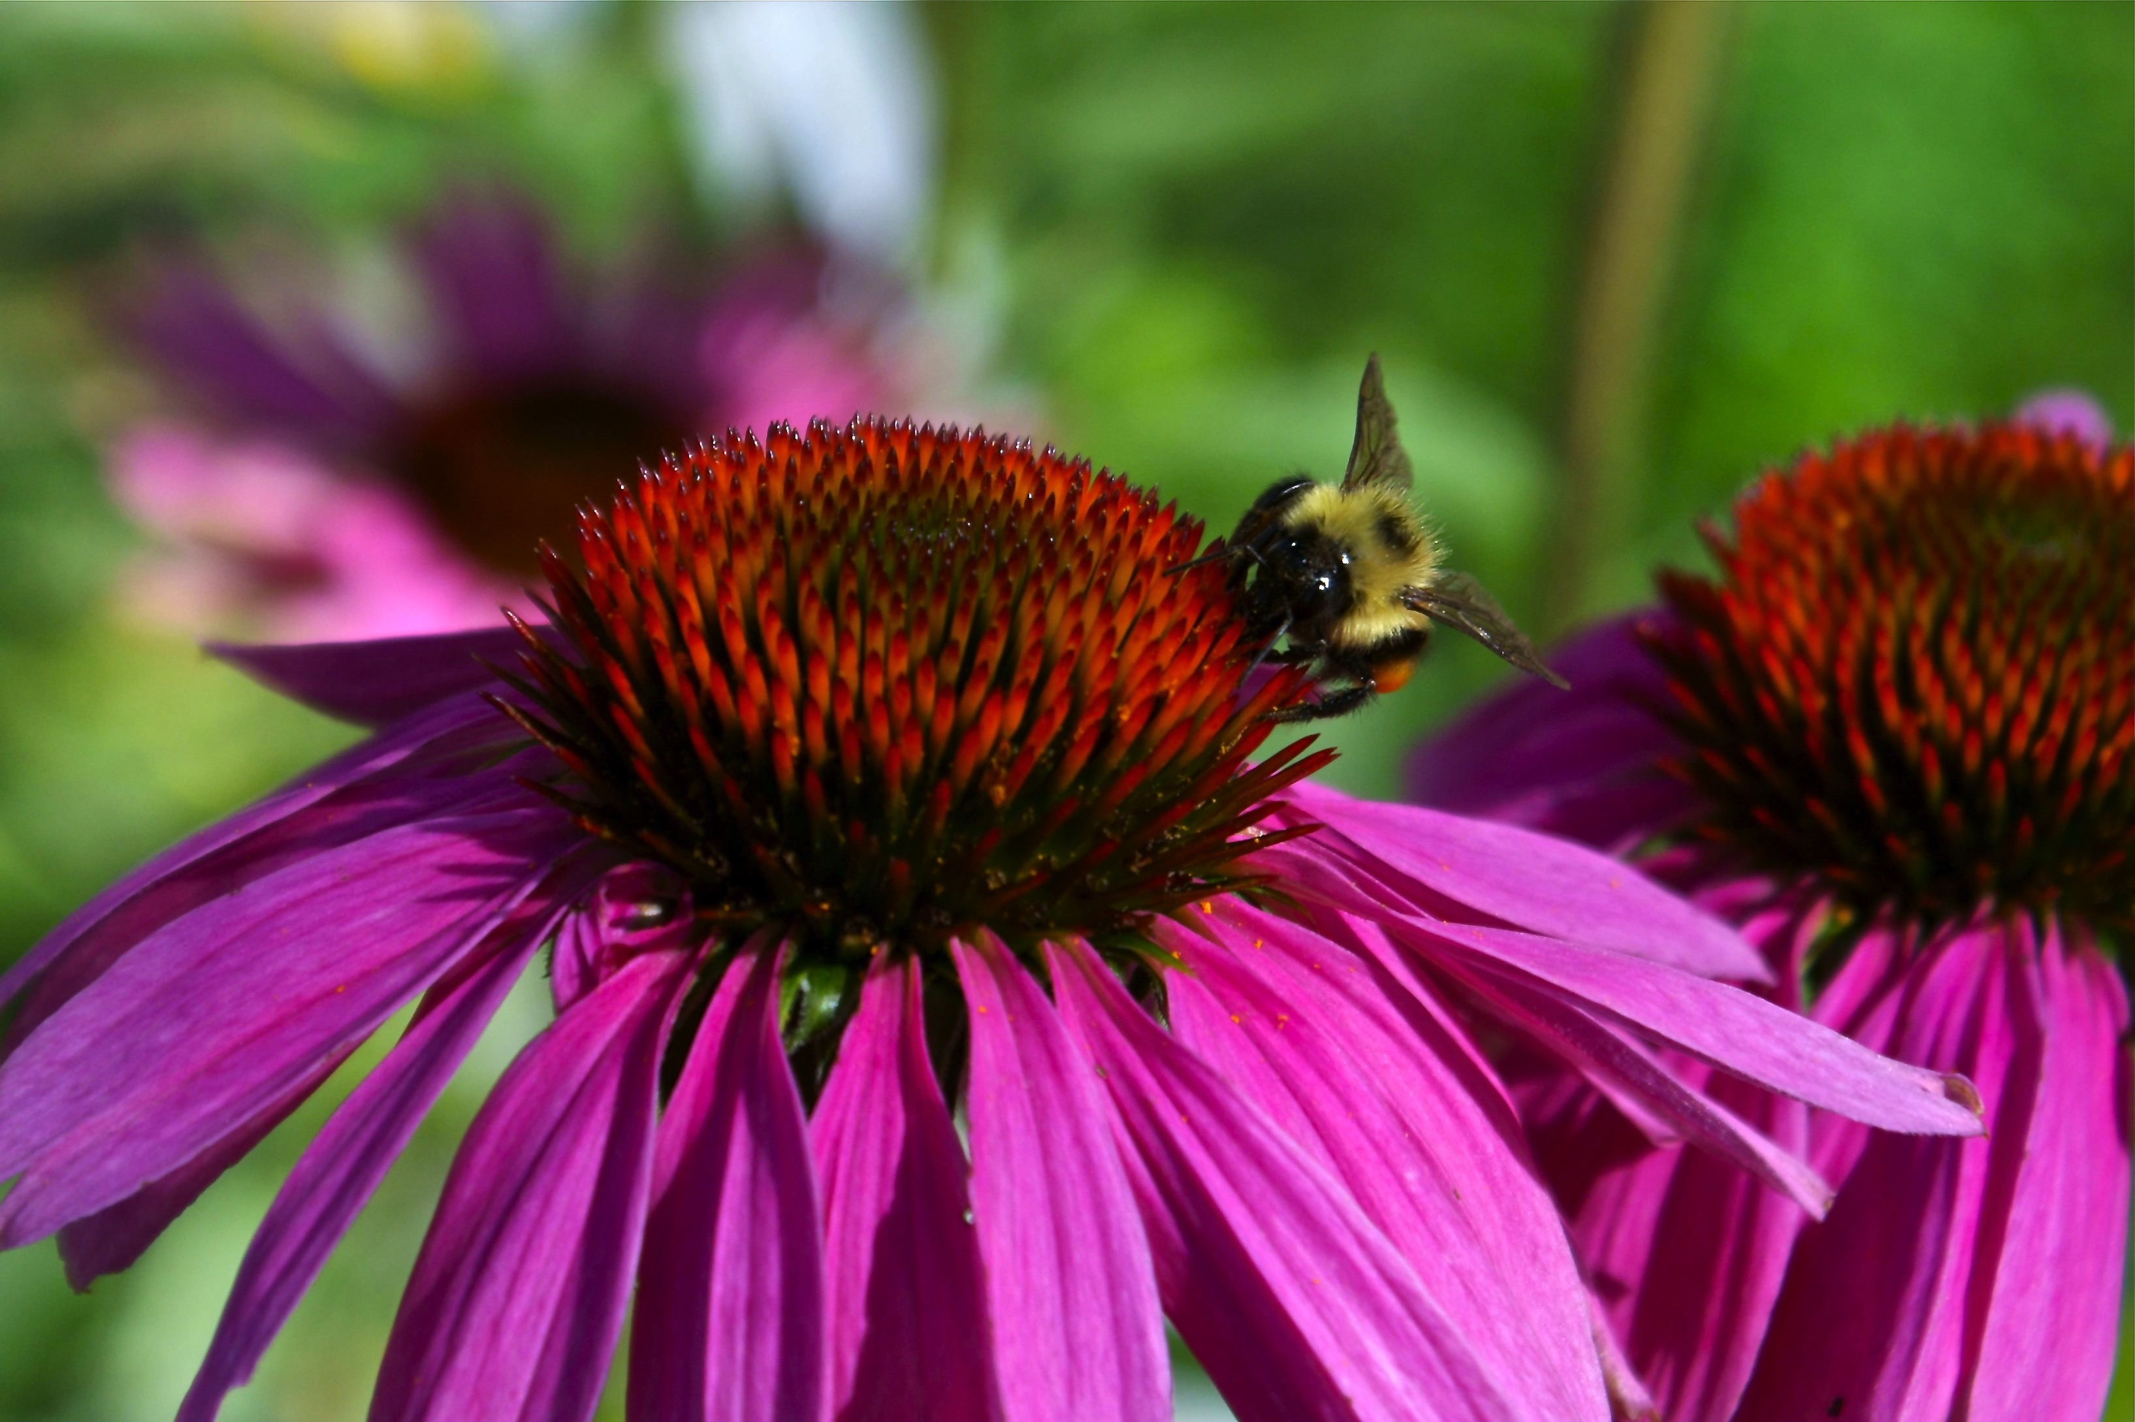

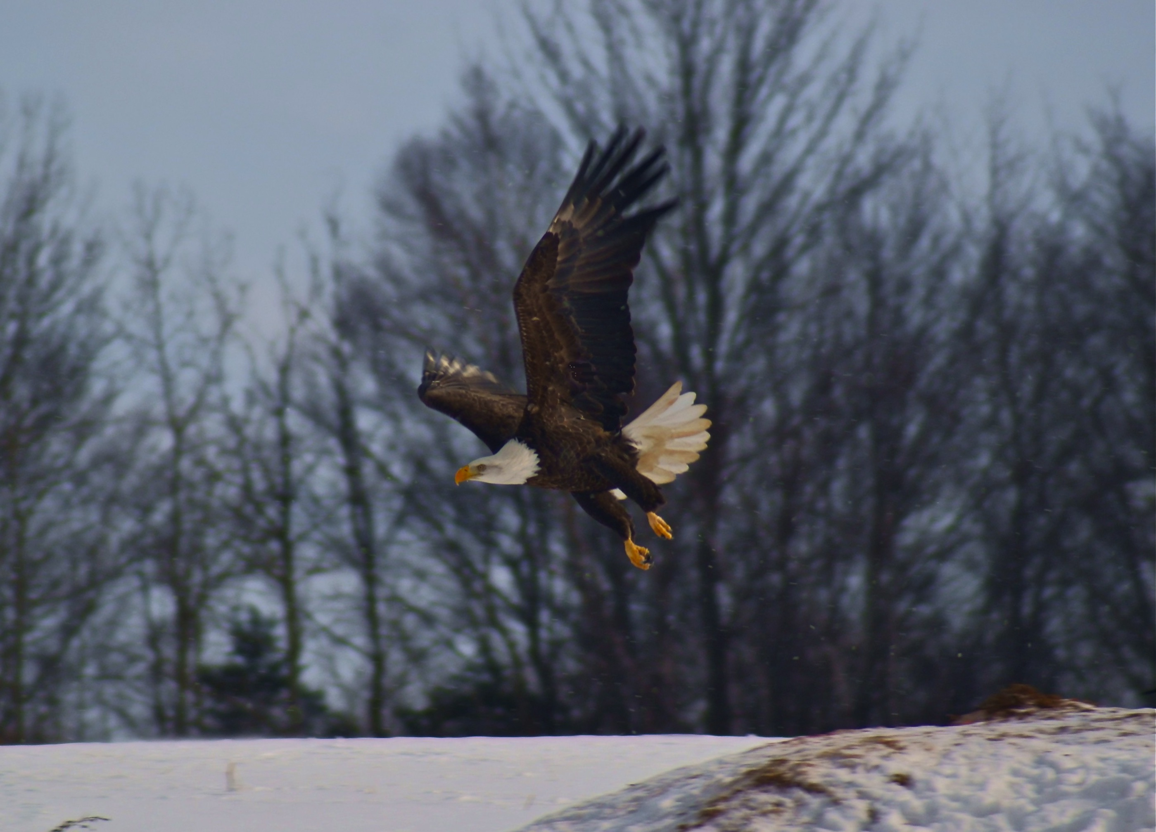



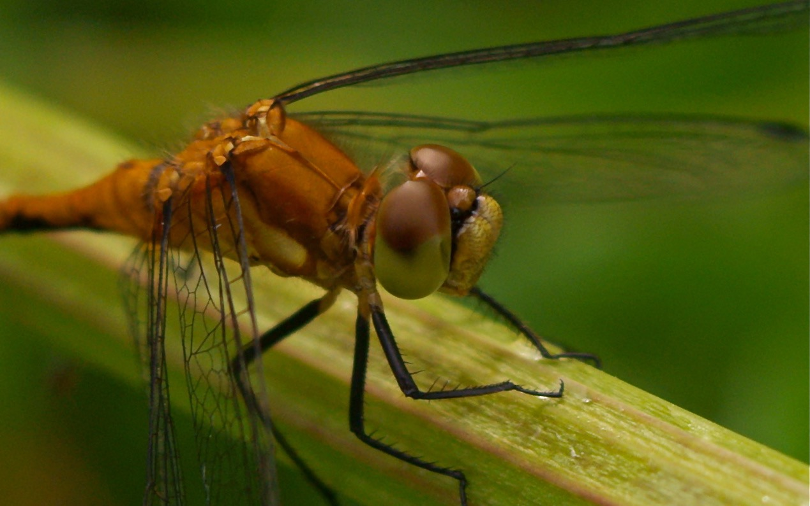
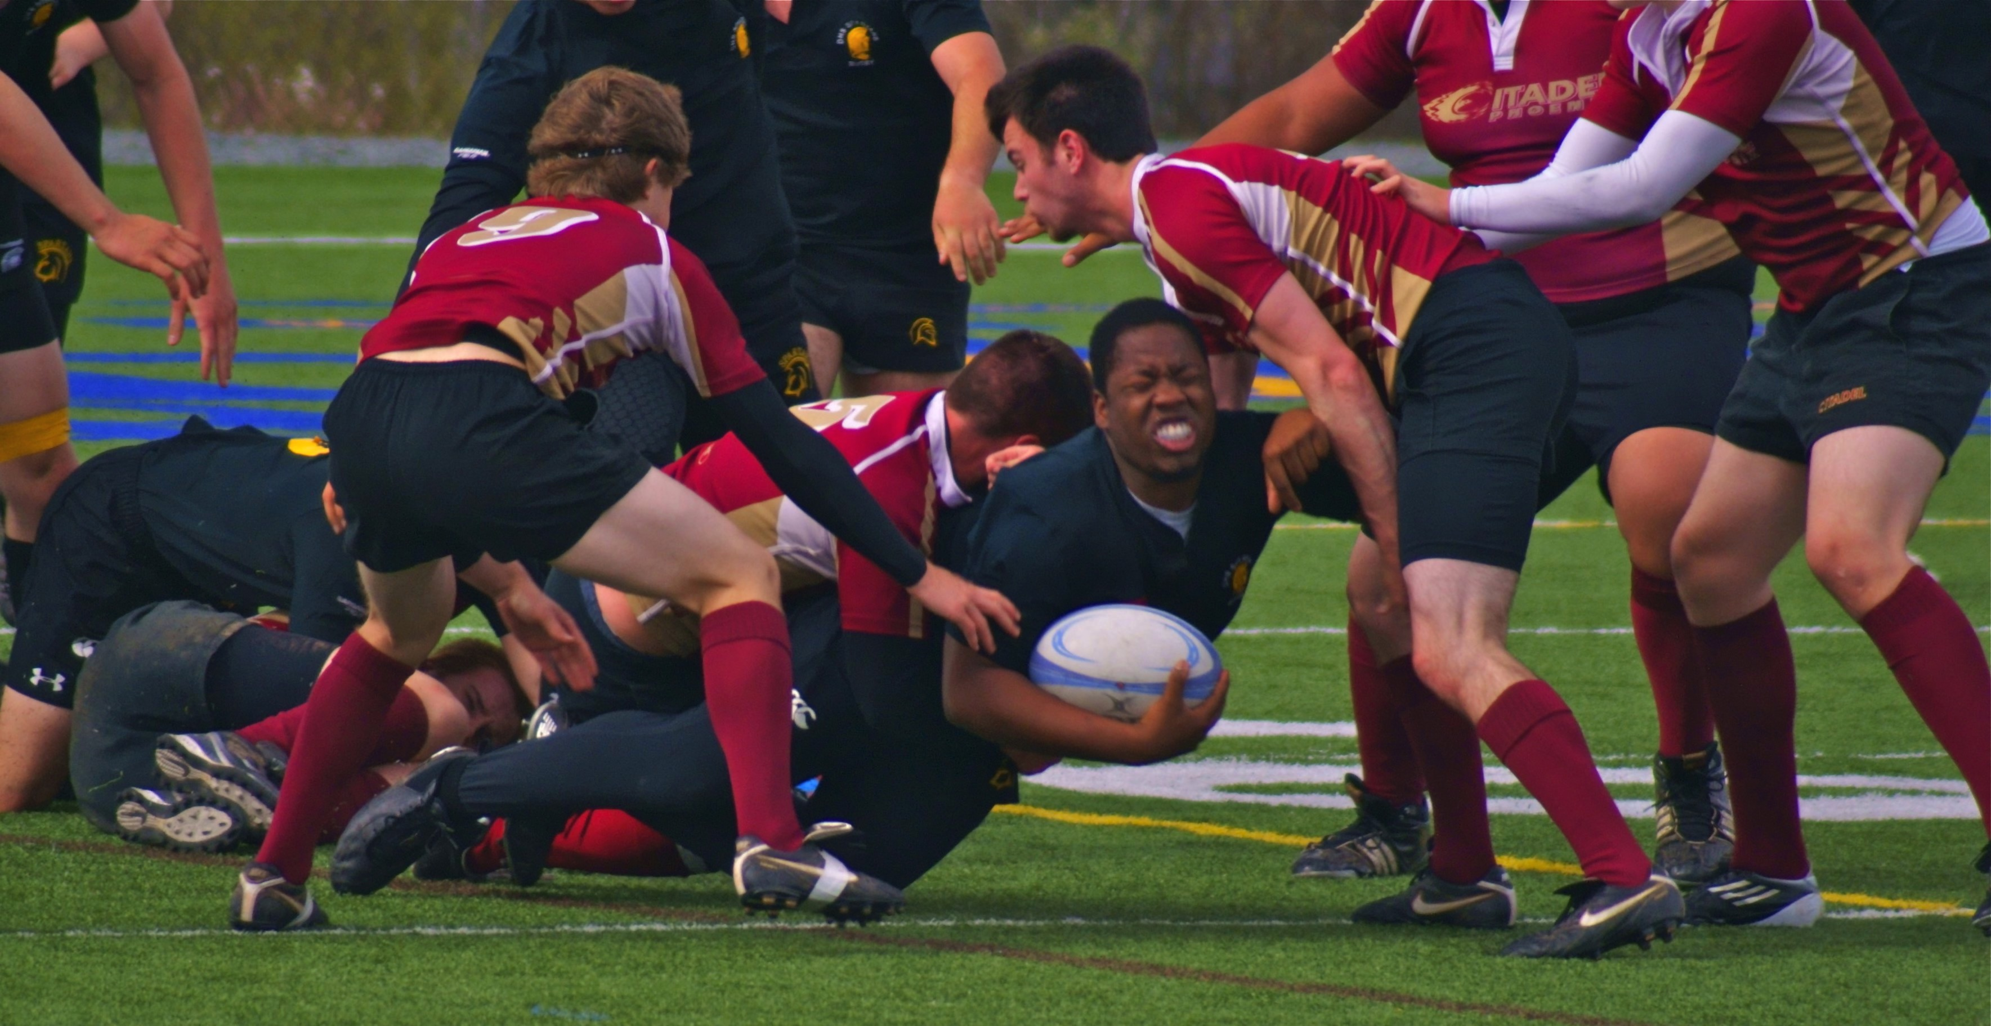
My Hobbies: Photography
Here are some examples...

Slide 12


I am Canadian – not American.
Vancouver
Halifax

Slide 13
Put your cellphone on your desk where I can see it and only use it in class to look up something you don’t understand or to take a photo of ppt.

Slide 14
What is this class?
The syllabus:
1. Take time to read the syllabus and note any questions you might have.
2. Let’s read over the syllabus together.
Pay attention and raise your hand if you do not understand something.

Slide 15
Fall Office Hours
Office Hours Fall 2019 October 8 – December 27
 | Monday | Tuesday | Wednesday | Thursday | Friday
8:00-9:35
9:50-11:25 | Mr. Rolfe
LUNCH |  |  |  | Ms. Bumann
1:20-2:55 |  | Mr. Mann |  | Ms. Stetson
3:10-4:45 | Mr. Klompmaker |  |  | Mr. Bumann
DINNER
6:00-8:00 |  | Ms. Groth

Slide 16
Syllabus: Objectives
The purpose of this course is to improve your oral
English in four ways:
1. Fluency
2. Pronunciation and spoken grammar
3. Cultural appropriateness when speaking with Westerners
4. Vocabulary
We will do this by discussing a variety of principles surrounding leadership and focusing on a specific aspect of English grammar and pronunciation each week. There will also be group projects through which you will practice these leadership and oral English skills. Unlike your high school English courses, helping you pass an exam is not the goal of this class.

Slide 17
Fluency vs. Accuracy
Fluency – the ability to speak a language steadily with few stops or pauses. Fluency is like the flow of water. This is perfected through practice.
Accuracy – the ability to speak a language without making mistakes in grammar, pronunciation and tenses. This is perfected through correction.
It is the intention of a language teacher to balance the importance of these two goals. Fluency builds confidence and accuracy builds communication.

Slide 18
Syllabus: Required Materials
Textbook – Modern Leadership Strategies from Ancient Chinese Wisdom, by Robert Foster
Notebook – that is specifically for this class
Paper – loose leaf
Pens – have them every class.

Slide 19
Syllabus: Expectations
Treat EVERYONE with respect. Remember that everyone makes mistakes (including me) and that is okay. DON’T BE SHY, JUST TRY!
Come to class prepared and on time.
Practice speaking English outside of class.
Use the practice time in class to your best advantage.
Do your work and only your work. Cheating and plagiarism will NOT be tolerated.
Encourage and help your classmates. THIS IS NOT A COMPETITION.
Have fun and do the best you can. I will. ☺

Slide 20
Syllabus: Attendance Policy
Every class missed will result in a grade reduction.
Students who miss more than three classes will not be permitted to take the final exam!
If you are late twice, it will be counted as one absence.
1 late + 1 late = 1 absence
If you miss a class, you will be expected to acquire the information you missed from a classmate or schedule with me to sit in the same class at another time. You are responsible for the information and assignments you missed – not me.
If you miss a class when there is a team project, you will get a zero for the project! They cannot be made up.

Slide 21
Let’s take a 5 minute break!

Slide 22
Syllabus: Grading Structure
Homework, Attendance
and Class Participation 15%
Quizzes 15%
Group Projects 20%
Midterm 10%
Final Exam 40%
Total 100%

Slide 23
Syllabus: Participation Points
In-class participation: Class participation points are recorded by the teacher when you participate in the class exercises. A total of 20 tallies are needed for full points in this category.
Attendance is 5% and homework completion is 5% of your grade.
Teacher’s evaluation of the successful completion of each group project is 4% of the Project Participation points.
Peer evaluation of how each of you performed your duties in the group during the project is 16% of Project Participation points.
This is 35% of your grade!

Slide 24
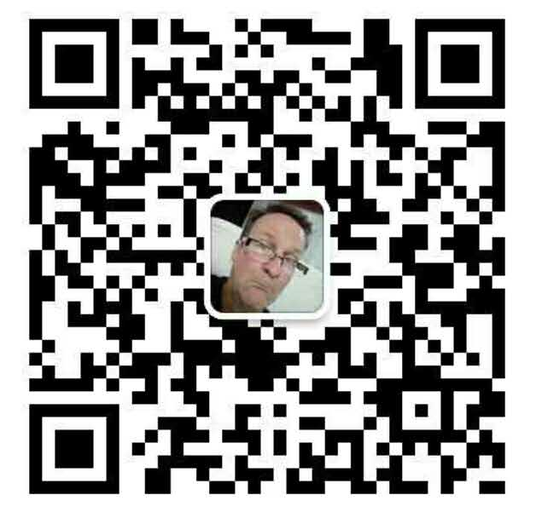

Syllabus: Resources
Contact me on WeChat: Pretty English Association (PEA)

Slide 25
How do I get the most out of this class?
BE PREPARED TO PRACTICE IN CLASS!
Your success in learning English in this class rests upon whether you participate in the activities or not.

Slide 26
Input vs. Output
There are three main ways the brain receives information: 1) through listening (lecture), 2) through watching (ppt slides), and 3) through doing (practicing). In this class, we will be balancing the amount of teaching I do (input) and the amount of practicing of English you do (output). The goal is to test the meaning of the question:
“Are students vessels to be filled, or lamps to be lit?”
Talk to your partner about what you think this question is asking.

Slide 27
How do I get the most out of this class?
BE PREPARED TO PRACTICE IN CLASS!
Your success in learning English in this class rests upon whether you participate in the activities or not.
DON”T CHEAT!
Cheating in Western culture is wrong and considered dishonourable. In this class, cheating will be taken VERY seriously.

Slide 28
What qualifies as cheating?
Copying another student’s completed homework.
Allowing a student to copy your completed homework.
Copying anything off of the internet without giving the site credit.
Copying anything out of a book without giving the author credit.
Asking another student to do your work for you.
Looking at another student’s test.
Allowing another student to copy your test.
Cheating steals from you the opportunity to learn and grow.

Slide 29
How do I get the most out of this class?
BE PREPARED TO PRACTICE IN CLASS!
Your success in learning English in this class rests upon whether you participate in the activities or not.
DON”T CHEAT!
Cheating in Western culture is wrong and considered dishonourable. In this class, cheating will be taken VERY seriously.
3. PRACTICE ENGLISH OUTSIDE OF CLASS!
Take advantage of the office hours and PEA activities.

Slide 30
Do you have an English name?

Slide 31
How to pick a good English name.
Avoid names that are just English words (e.g. snake, sky, evil, cloud, jar, lemon, etc.)
Avoid names that are not real names, or even real words (e.g. Lufy, Springla, Lawken, Pitel). They could be names in other languages, but not in English.
Avoid misspellings of names, e.g. Hedy (Heidi?), Bejamin (Benjamin?), Jam (Jim?), Mecial (Michael?), etc.
Avoid unusual or overly common celebrity names (especially family names!) e.g. Tiger Woods, Obama, Michael Jackson, Kobe Bryant, Avril Lavigne, etc.

Slide 32
What’s in a name?
Choose a name that won’t make a native English speaker think you are crazy, unintelligent, or strange. First impressions are very important in Western culture.
Choose a name that has meaning to you (a favourite character from a TV show, a name that sounds pretty to you, a name that’s similar to your Chinese name, a name with a good meaning, etc.).
Learn to spell your name correctly. Most English names also have short-forms that might be easier to spell, e.g. Michael = Mike; Elizabeth = Beth; Jessica = Jess; Nicholas = Nick; Daniel = Dan, etc.

Slide 33
Pick out a name:
Look at the name list for your gender and pick a name you like. Only one person in this class can have the same name. When you have chosen a name, please raise your hand.
From now on in this class, use your English name, with your class name, and student number on all assignments and correspondence. Your class name is Beaver.
During this time, start filling out the information sheet.

Slide 34
Homework:
Bring 5 RMB to class for copies.
Study the syllabus.
Finish filling out the Student Information Survey and bring it to the next class.

